Slide 1

HOME EASE
HomeEase - Home Service Booking Platform
A Seamless Way to Connect with Service Providers

Slide 2
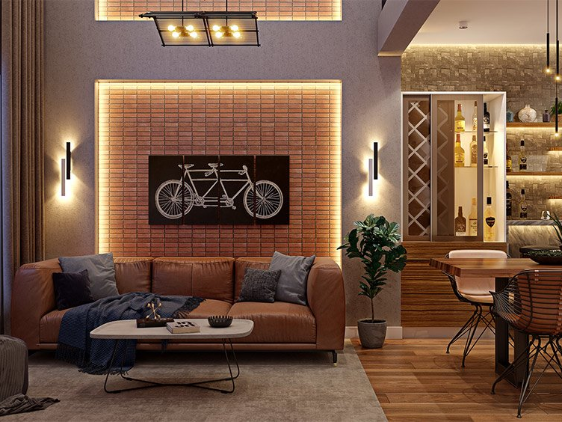
Project Overview
Web-based platform for home service bookings
Connects users with verified service providers
Users can browse, book services, submit inquiries, and provide feedback

Slide 3


Key Features
Secure Authentication : Login required
Home Page: Overview of services
-Service Provider Listing : Name, rating, location, Book Now
Booking System: Users schedule services
Inquiry Form : Users submit queries
Contact Page : Map & contact details
Feedback System : Users submit feedback, updating provider details

Slide 4

Technology Stack
- Frontend: Angular (TypeScript)
- Styling: Bootstrap, CSS
- API Handling: Angular Services & RxJS
- Routing: Angular Router (configured in app-routing.module.ts)
- State Management: Observables & Services
- Component Structure: Modular & reusable for better development workflow
- Data Handling:
• Local Storage: Stores authentication details & user feedback
• Angular Services: Manages dynamic data flow
- Authentication & Security:
• Login redirects to Home Page after authentication
• AuthGuard restricts access to prevent unauthorized navigation

Slide 5

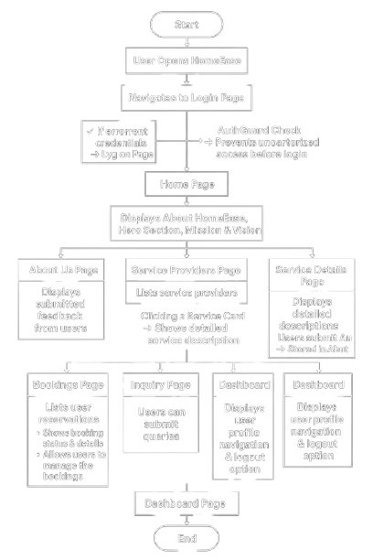
Navigation Flow

Slide 6
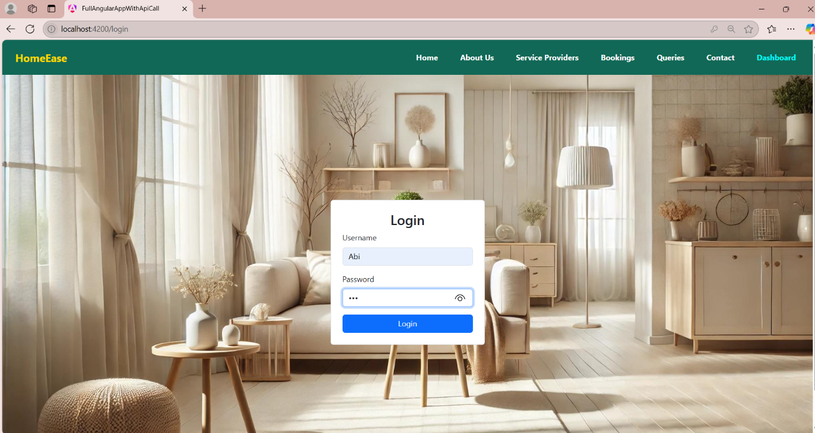
Login Page
Users enter credentials to access the platform securely.

Slide 7
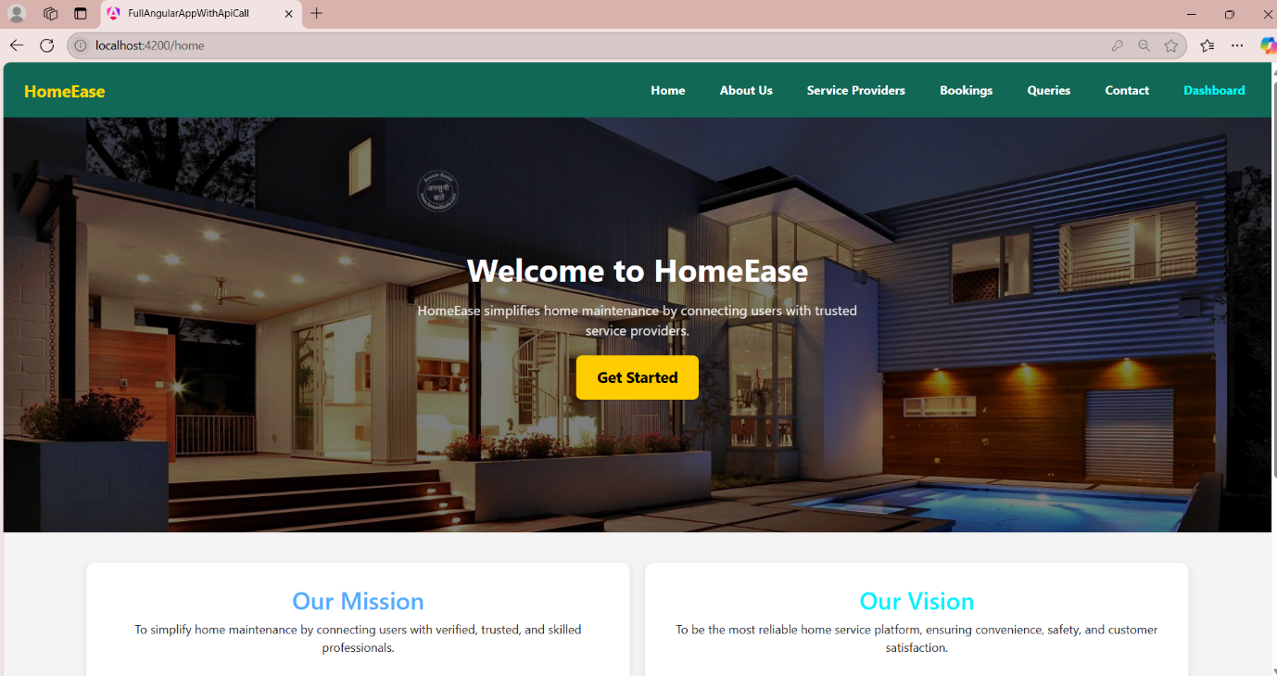
Home Page
Displays mission, vision, and an overview of HomeEase.

Slide 8
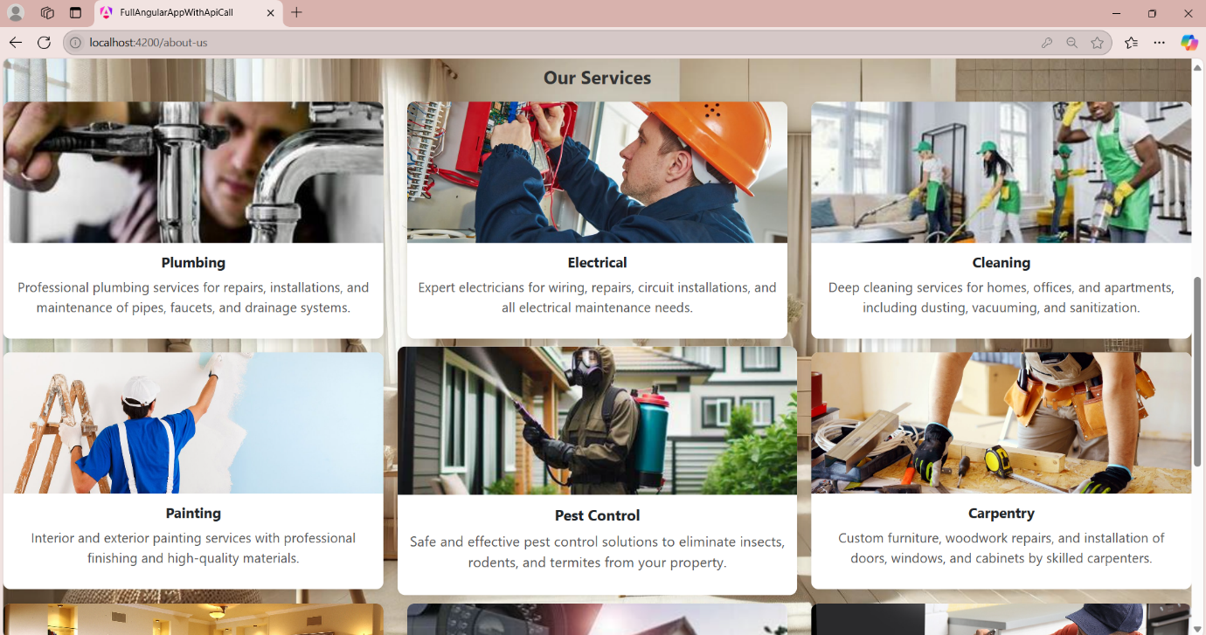
About Us Page
Displays service categories with brief descriptions, while each service card contains a detailed description and user feedback. Submitted feedback is sent to the About Us page for display.

Slide 9
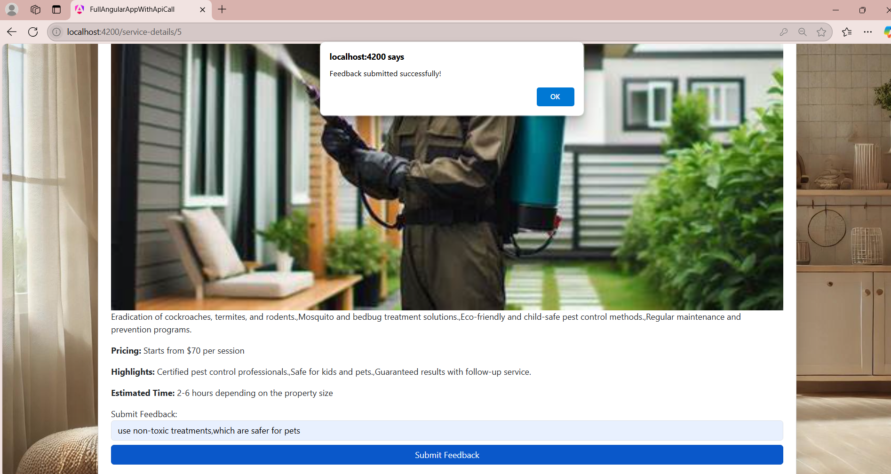
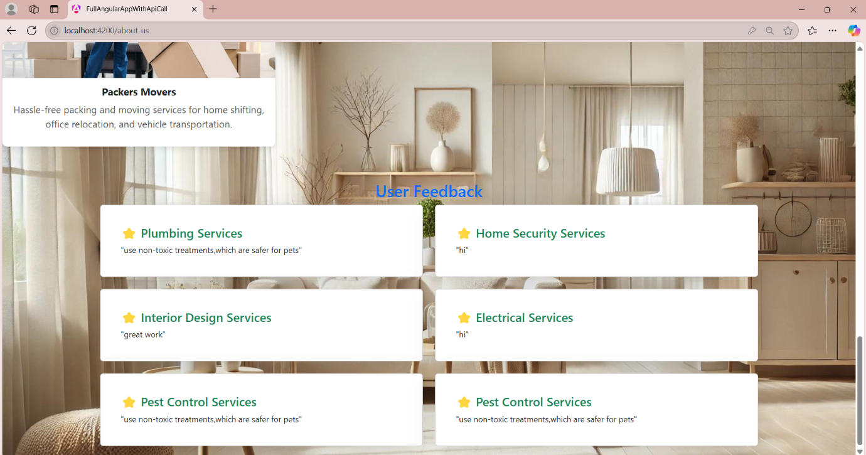

Slide 10
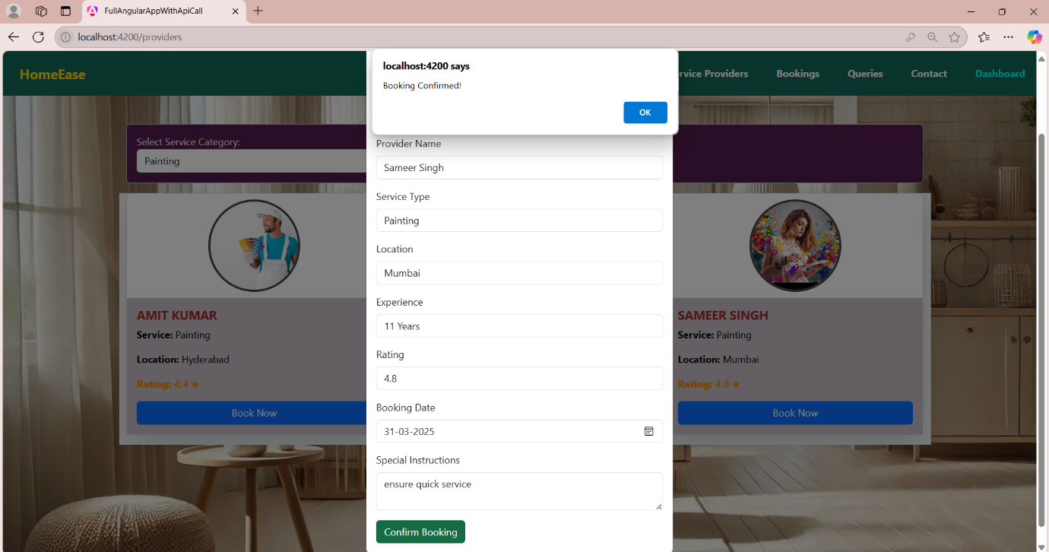
Service Provider Page
Lists providers with details like name, rating, and location, along with a "Book Now" option. Booked services are displayed in the Bookings Page.

Slide 11
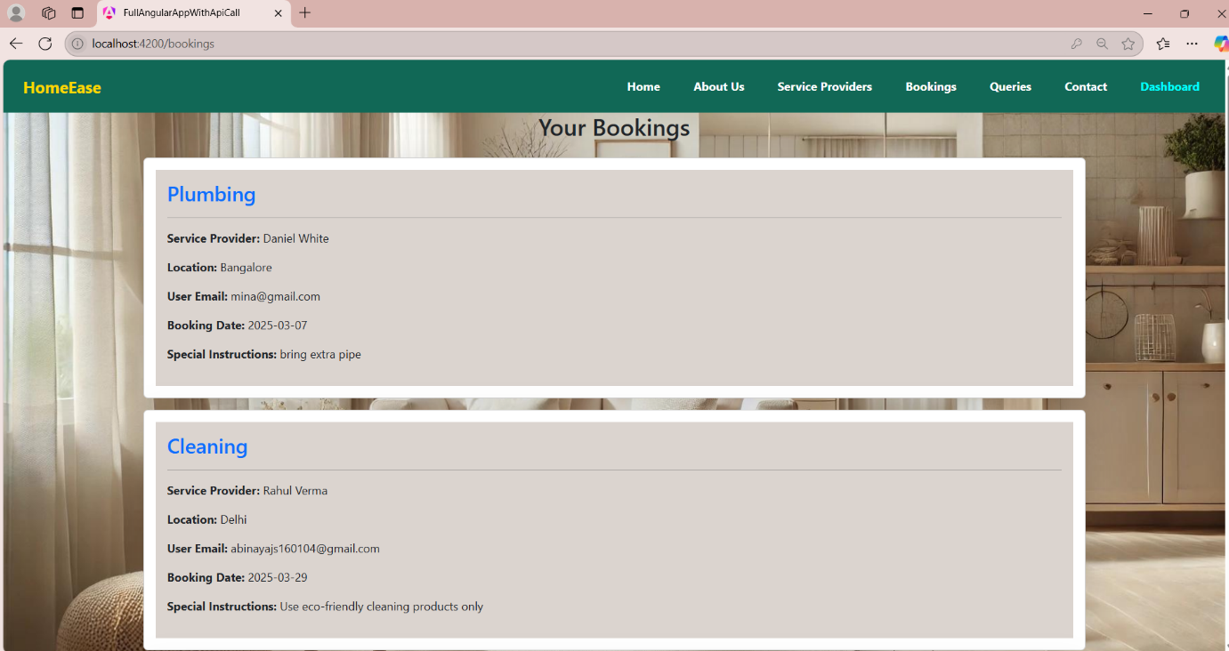
Booking Page
Lists user reservations, displays booking status and details, and allows users to manage their bookings.

Slide 12
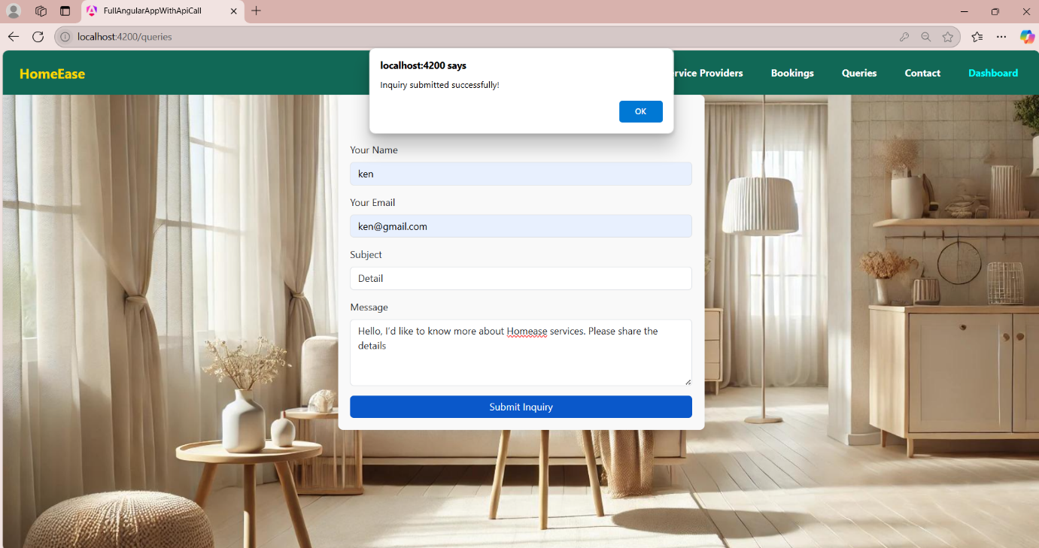
Inquiry Page
Allows users to submit queries for assistance.

Slide 13
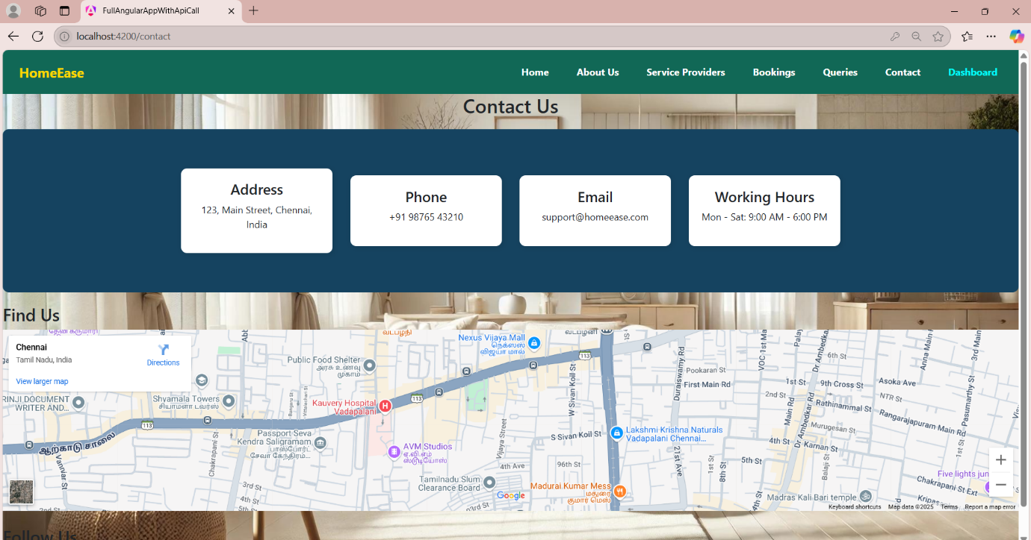
Contact Page
Displays company location, contact details, address, working hours, and an interactive map for easy navigation.

Slide 14
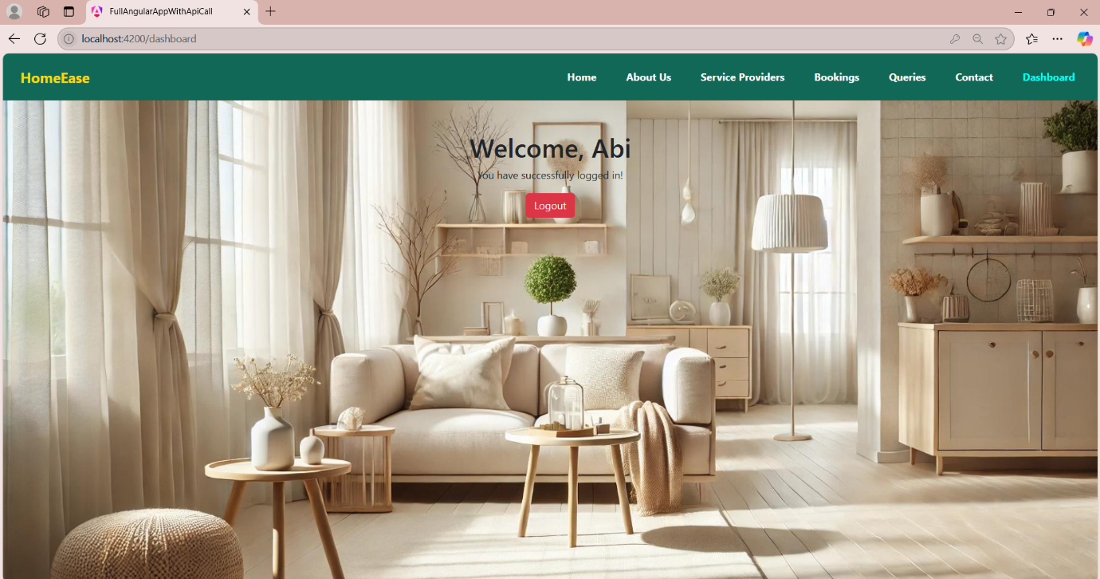
Dashboard Page
Displays user profile with navigation and logout option.

Slide 15

Conclusion
✅ HomeEase simplifies home service bookings ✅ Secure authentication ensures data protection ✅ Modern web technologies provide a smooth experience ✅ User-friendly navigation enables hassle-free booking

